Slide 1

C O R AL
SAVESCRIPTION

Slide 2
CURRENT SITUATION
“Estimated 25,000 deaths in the European Union that are caused by antibiotic resistant bacteria” World Health Organization, 2015
“Medical cost of patients with antibiotic resistant bacteria falls somewhere between $18,588 to $29,060 per patient” Ventola, 2015

Slide 3
DECISION CRITERIA
Ultimate goal:
Increase communication between patients and doctors
Provide patients knowledge on importance of medication
Ultimate Goal:
Organize pill schedule and give information on how to intake the medication
Focus on health and let this app accommodate to their medical needs
Ultimate Goal:
Reduce user error for medicine intake
Decrease chances for “superbug” mutations
Lower health industry costs

Slide 4
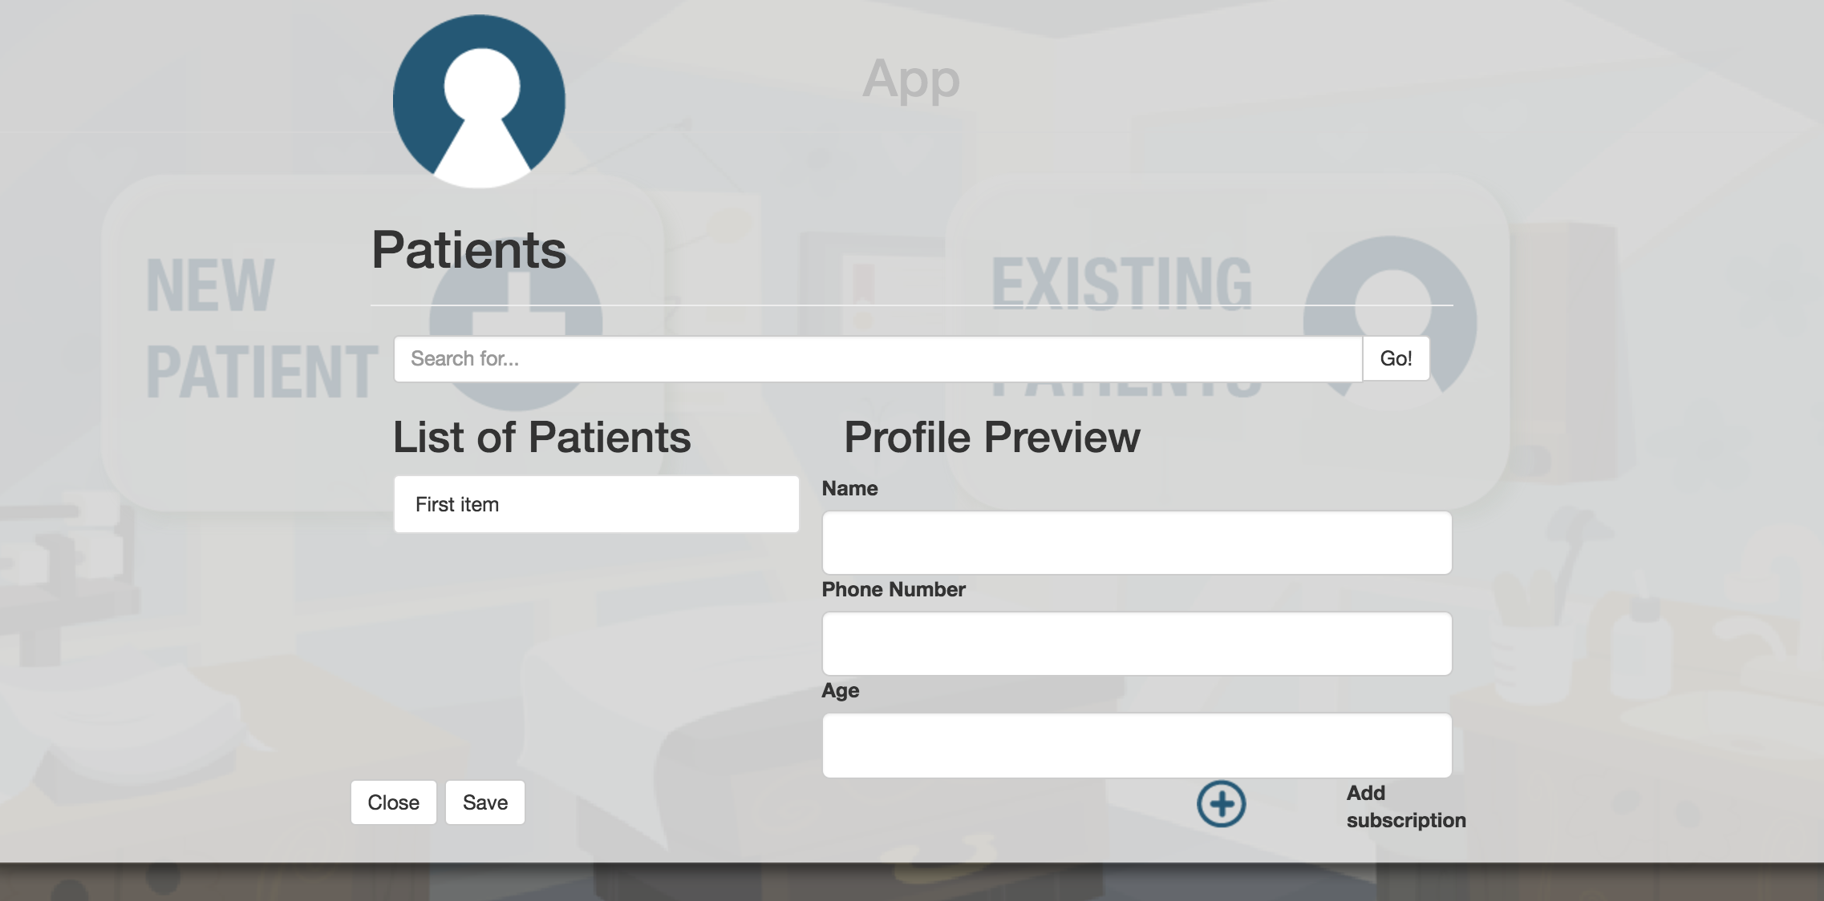
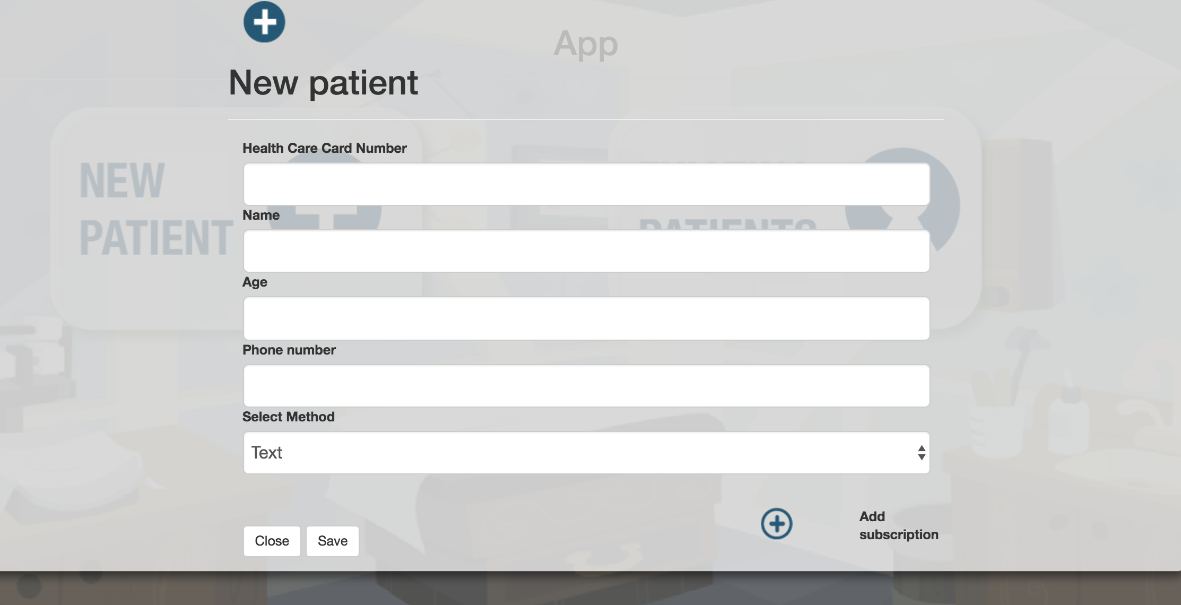
COMMUNICATION
Option for patients to receive calls and/or texts
Easy access to information for doctor’s contact
Details on medication and possible side effects

Slide 5
SCHEDULE
Receive call when it is time to take medication
Focus on health instead of when to take pills
Increase knowledge on the medication that they are using

Slide 6
ULTIMATE GOAL
Decreases chances of antibiotic resistant bacteria
Lower the rate of people affected by prescription related illnesses
Lower health care cost per person by reducing user error

